Slide 1

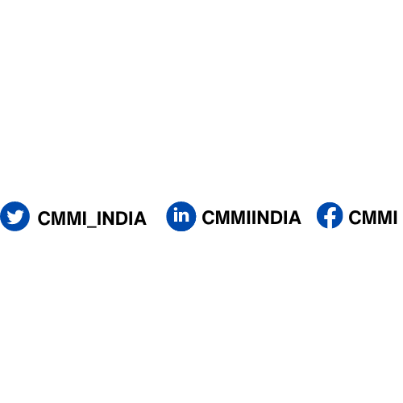
The Company of Master Mariners of India
    K. Raheja Prime, 5th Floor,Sag Baug Road Marol,
    Andheri (East), Mumbai 400 059
    Tel: 98218 39084 | 98195 33239
    Email: office@cmmi.co.in
    Web-Site: www.cmmi.co.in

Slide 2

ABOUT
❖ Only Professional body of Master Mariners in India
CMMI
❖ Registered under section 25 of the Company’s Act 1956
❖ Formed in 1957 by few Master Mariners
❖ 21 Chapters (branches) across India and abroad,
❖ Has membership base of over 3900 members and growing.

Slide 3

OBJECTIVES
To provide a central body representative of Senior Officers for the purpose of developing and promoting traditions and efficiency of Merchant Navy.
❖
❖
❖
❖
To encourage and maintain high and honourable standard of ability and professional conduct in the officers.
To promote and maintain efficient and friendly co-operation between the Merchant Navy and Indian Navy.
To collect, circulate, publish and distribute statistics & other information relating to Merchant Navy or to Nautical
Science.
❖
To constitute a body of experienced seaman who will able to act as members of, or to give any evidence before
any Government of India Commissions, Courts of enquiry, Committees, Boards of any description etc
❖
To provide facilities for discussion and study of matters concerning or affecting the Merchant Navy or sea craft,
navigation or nautical science.
❖
To Provide a central consultative body to advise on all matters connected with safety and preservation of ships,
passengers, seaman and cargo.
❖
To print, publish and distribute periodicals, books etc.
❖
To Promote & foster continual professional development by organising lecture meetings & Seminars on topical
issues for the Maritime Industry.

Slide 4
MAIN
ACTIVITIES
OF
CMMI
❖
❖
❖
❖
❖
❖
❖
Publish Command Journal Quarterly
Assist DGS with External examiners for Mates & Master’s oral exam
Assist DGS in various advisory committee
Part of Indian Delegation to IMO
Organise family gathering once a year
Organise Monthly lecture meeting
Organise Seminar at least twice a year
co-founder and trustee of the "Board of Examination for Seafarers" trust

Slide 5
MAIN
ACTIVITIES
OF
CMMI
❖
❖
❖
❖
❖
❖
Advise BES on various matter (Exit exam for rating & IV exam)
Prepare & distribute TAR book for 3 years B.Sc. Nautical Cadets
Launched Mentoring Scheme
Holds 'MASTERCLASS' sessions periodically
Collaboration with IMU in establishing 'Policy Research Cell’
Conduct on-line classes for EXTRA MASTER’s
Maintains a library with a collection of wide range of nautical publications.

Slide 6

WHAT
❖ Receive Command Journal free
IS
THERE
FOR
ME?
❖ Get nominated in various committee
Spectrum
❖ Chance to increase horizon in Maritime
❖ Free to attend monthly lecture meeting
❖ Free to attend seminar (Twice a year)
❖ Subsidised rate for entry in social gathering
❖ Feel proud to be part of professional body

Slide 7
CAN DO
We need to create a vibrant body of professionals who will then have a say in the development of Competence & skills in the Nautical side. We should become the
backbone on which Government should rely for professional inputs.
Let us start membership drive & bring more professionals in our fold & Open more chapters around the world.
THANKS

